Slide 1



JAL JEEVAN MISSION
NABARD CONSULTANCY SERVICES
PROGRESS REPORT
DISTRICT: THANE
KONKAN REGION
MARCH 2023

Slide 2
District Work Status
Taluka | Category | No. of Schemes | Work Order Issued | Work In Progress | Work Not Started
Shahapur | Retro | 85 | 84 | 44 | 40
 | New | 36 | 35 | 13 | 22
Total |  | 121 | 119 | 57 | 62

Slide 3
Executive Summary Work in Progress Schemes
Taluka | Category | Total No. of Schemes | No. of Schemes based on Physical Progress %
 |  |  | < 25% | 25 < 50% | 50 < 75% | 75 < 100% | Commissioned
Shahapur | Retro | 44 | 44 | 0
 | New | 13 | 12 | 1
Total |  | 57 | 56 | 1

Slide 4
Abstract of Schemes – Work in Progress Category – “Retro”
Sr No | Scheme Name | Name of Agency | W.O. Amount (excl GST) | W.O. Date | Construction Period | Physical Progress
Shahapur Taluka | Shahapur Taluka
1 | Bhatsai | Vaibhav Ravikant vishe | 96,69,103 | 12-26-2022 | 12 Months | 0.31%
2 | Ratandhale | Yogesh Farde | 50,74,998 | 18-11-2022 | 12 Months | 0.24%
3 | Kharivalis | Sudarshan Dashrath Shelar | 89,73,701 | 17-01-2023 | 12 Months | 7.76%
4 | Kharivali SO | Jha.P. & Company | 87,47,152 | 11-30-2022 | 12 Months | 0.66%
5 | Pivali | Leena Pandurang Patil | 68,34,676 | 30-11-2022 | 12 Months | 8.70%
6 | Sakhroli | Bhushan Raghunath Gharat | 62,76,456 | 11-30-2022 | 12 Months | 0.52%
7 | Umbhrai | Yogesh Nandkumar Malvani | 69,70,320 | 12-13-2022 | 12 Months | 2.20%
8 | Musaiwadi | Bhagvati Enterprises | 88,25,444 | 18-11-2022 | 12 Months | 4.06%
9 | Cheravali | Nitesh Malvani | 71,77,019 | 18-11-2022 | 12 Months | 15.58%
10 | Hiv | Roshan Kisan Deshmukh | 1,27,43,612 | 11-18-2022 | 12 Months | 0.02%
11 | Ras | Roshan Kisan Deshmukh | 33,62,289 | 18-11-2022 | 12 Months | 1.05%
12 | Neharoli | Bhagwati Enterprises | 1,54,40,402 | 18-11-2022 | 12 Months | 0.98%
13 | Sane Pali | Bhagvati Enterprises | 92,73,927 | 30-11-2022 | 12 Months | 11.73%

Slide 5
Abstract of Schemes – Work in Progress Category – “Retro”
Sr No | Scheme Name | Name of Agency | W.O. Amount (excl GST) | W.O. Date | Construction Period | Physical Progress
14 | Khardi | Nitesh Mohan Malvani | 3,98,49,875 | 1-17-2023 | 12 Months | 9.58%
15 | Hal | Bhagvati Enterprises | 43,22,119 | 18-11-2022 | 12 Months | 0.31%
16 | Kanadi | Bhagvati Enterprises | 76,83,300 | 18-11-2022 | 12 Months | 17.42%
17 | Khaire | Bhagvati Enterprises | 93,39,374 | 18-11-2022 | 12 Months | 2.18%
18 | Mugaon | Bhagvati Enterprices | 62,48,604 | 11-18-2022 | 12 Months | 8.90%
19 | Pofodi | Roshan Kisan Deshmukh | 42,19,583 | 18-11-2022 | 12 Months | 16.31%
20 | Sogaon | Nitesh Mohan Malvani | 87,11,464 | 18-11-2022 | 12 Months | 0.69%
21 | Atgaon | Lina Pandurang Patil | 1,04,32,835 | 18-11-2022 | 12 Months | 0.42%
22 | Alyani | A.K.Electricals | 1,13,57,624 | 18-11-2022 | 12 Months | 0.58%
23 | Dahagaon Katbao | Bhagvati Enterprises | 1,09,84,301 | 18-12-2022 | 12 Months | 6.67%
24 | Kharid | Rajesh construction | 1,01,24,832 | 11-18-2022 | 12 Months | 1.12%
25 | Nandgaon | Bhagvati Enterprises | 65,42,136 | 18-11-2022 | 12 Months | 0.34%
26 | Pimpalpada | Akshay Maruti Bhoir | 49,87,962 | 11-18-2022 | 12 Months | 0.48%
27 | Kanvinde | Leena Patil | 43,50,115 | 18-11-2022 | 12 Months | 0.55%

Slide 6
Abstract of Schemes – Work in Progress Category – “Retro”
Sr No | Scheme Name | Name of Agency | W.O. Amount (excl GST) | W.O. Date | Construction Period | Physical Progress
28 | Lingayatgaon | Nikhil Ravindra Gharat | 69,67,360 | 18-11-2022 | 12 Months | 0.30%
29 | Umbarkhand | Yogesh Farde | 55,65,853 | 18-11-2022 | 12 Months | 0.59%
30 | Shelavali Kh | Mayur Govind Vishe | 1,16,29,927 | 22-12-2022 | 12 Months | 0.36%
31 | Kudshet | Mayur Govind Vishe | 77,35,398 | 17-01-2023 | 12 Months | 0.40%
32 | Aware | Jha. P. & Company | 1,17,24,621 | 22-12-2022 | 12 Months | 0.32%
33 | Kanave | Nitesh Malwani | 73,29,898 | 18-11-2022 | 12 Months | 4.64%
34 | Shilottar | Nilesh Lakade | 33,22,886 | 18-11-2022 | 12 Months | 3.60%
35 | Shendegaon | Pundlik Gajanan Sapat | 1,51,40,993 | 22-12-2022 | 12 Months | 23.72%
36 | Chariv | Yogesh Suresh Farde | 53,48,308 | 12-13-2022 | 12 Months | 0.44%
37 | Chikhalgaon | Rajesh Construction | 1,63,00,078 | 18-11-2022 | 12 Months | 1.81%
38 | Sarangpuri Bamanpada | Pundlik Gajanan Sapat | 1,60,30,761 | 18-01-2023 | 12 Months | 0.30%
39 | kukambe | Akshay Maruti Bhoir | 1,07,62,708 | 12-13-2022 | 12 Months | 5.44%
40 | Nadgaon | Lina Pandurang Patil | 2,40,72,164 | 26-12-2022 | 12 Months | 0.04%
41 | Kharangan | Roshan Deshmukh | 69,48,498 | 18-11-2022 | 12 Months | 0.95%

Slide 7
Abstract of Schemes – Work in Progress Category – “Retro”
Sr No | Scheme Name | Name of Agency | W.O. Amount (excl GST) | W.O. Date | Construction Period | Physical Progress
42 | VEHALOLI BK | Budharani Dharmu Indandas | 1,43,64,801 | 12-22-2022 | 12 Months | 0.64%
43 | Chandrichapada& Nibhalpada | .Bhushan Ganpat Patil | 76,86,061 | 18-11-2022 | 12 Months | 0.09%
44 | Sapgaon | Leena Pandurang Patil | 1,58,41,789 | 28-02-2023 | 12 Months | 0.12%

Slide 8
Abstract of Schemes – Work in Progress Category – “New”
Sr No | Scheme Name | Name of Agency | W.O. Amount (excl GST) | W.O. Date | Construction Period | Physical Progress
Shahapur Taluka | Shahapur Taluka
1 | Bedisgaon, Alyani | A.K. Electricals | 77,05,435 | 18-11-2022 | 12 Months | 35.67%
2 | Koshimbade | M/s Bhagvati Enterprices | 1,09,84,302 | 18-11-2022 | 12 Months | 0.65%
3 | Vandre | Bhagvati Enterprises | 1,19,37,311 | 11-18-2022 | 12 Months | 0.13%
4 | Dahivali-Bhagdal-Masanepada | Jha.P & Company | 3,29,63,009 | 17-01-2023 | 12 Months | 0.07%
5 | Vithobachegaon | A.K.Electrical Works | 81,43,819 | 11-18-2022 | 12 Months | 1.76%
6 | Manekhind | Pramod Janardan Vishe | 39,89,140 | 18-11-2022 | 12 Months | 0.65%
7 | Ashte |  | 36,70,325 | 18-11-2022 | 12 Months | 0.23%
8 | Sathgaon | Jha. P. & Company | 1,00,16,466 | 30-11-2022 | 12 Months | 14.48%
9 | Dahivali | Nilesh Lakade | 1,34,41,575 | 18-11-2022 | 12 Months | 0.25%
10 | Tute (Kharivali) | Sudarshan Dashrath shelar | 57,72,260 | 18-01-2023 | 12 Months | 2.85%
11 | Shidpada (Junawani) | Bhushan Ganpat Patil | 55,12,377 | 02-18-2023 | 12 Months | 0.56%
12 | Mal | Deva Pabhakar Sodnar | 1,15,14,844 | 12-22-2022 | 12 Months | 3.34%
13 | Vehaloli KH | Sagar Shriram Vishe | 90,07,341 | 18-01-2023 | 12 Months | 4.21%

Slide 9
DASHBOARD

Slide 10
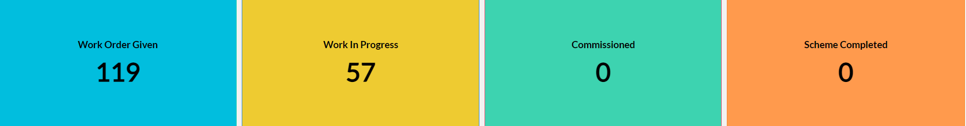
Dashboard
Work Status

Slide 11
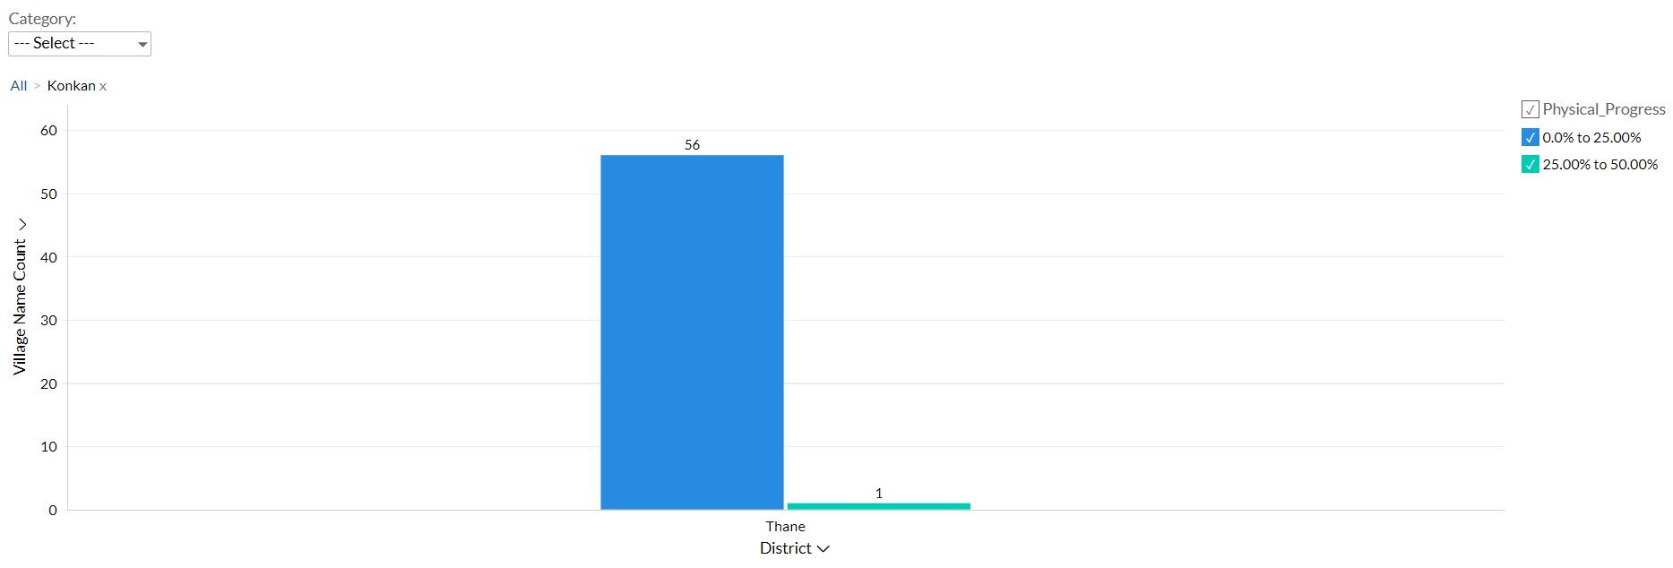
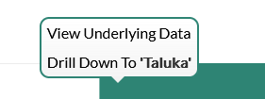
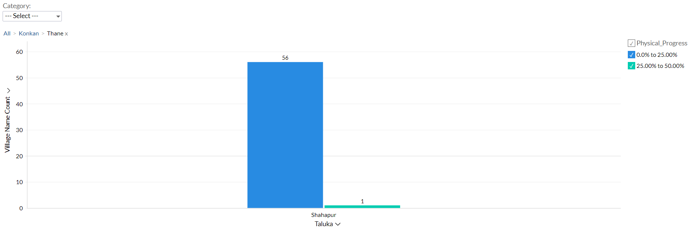
Dashboard
Progress Milestone

Slide 12
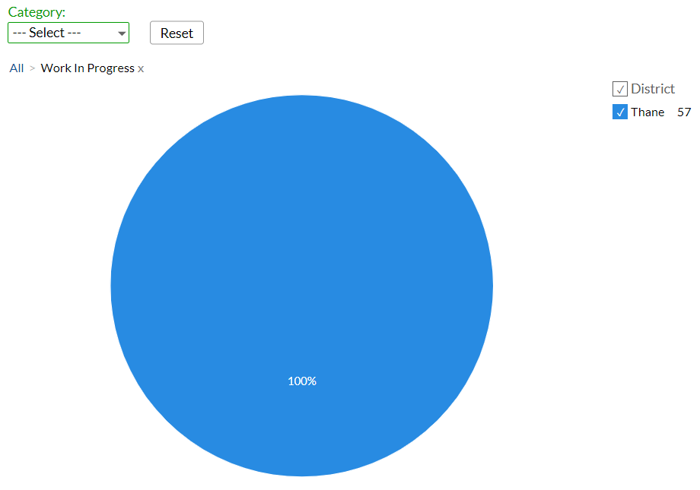
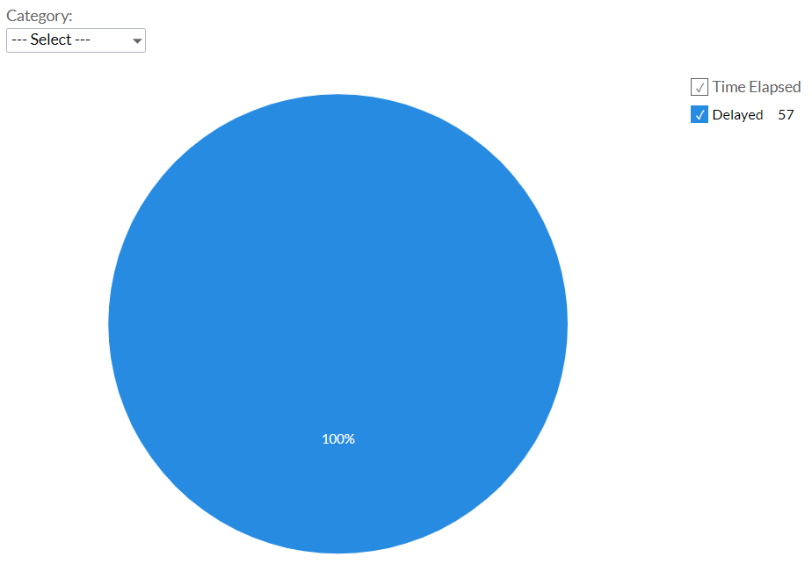
Dashboard
Work Status:
Scheme Status:

Slide 13
MS – PROJECT
Work in Progress Schemes

Slide 14
Project Overview Physical Progress vs Financial Progress vs Time Overrun

Slide 15
Late Schemes

Slide 16
SAMPLE SITE VISIT PHOTOS

Slide 17
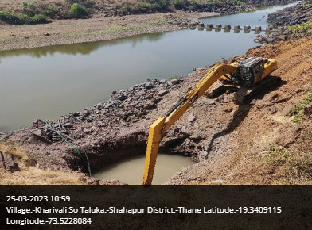
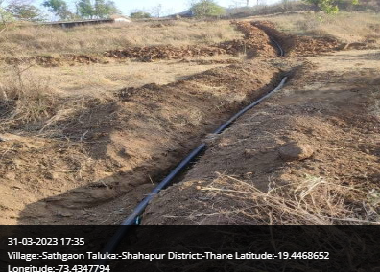
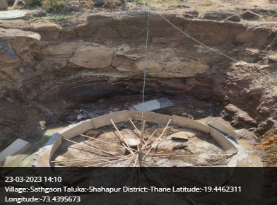
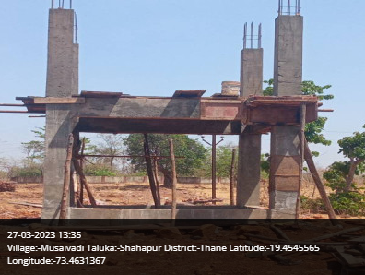
Shahapur Taluka

Slide 18
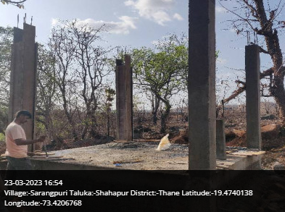
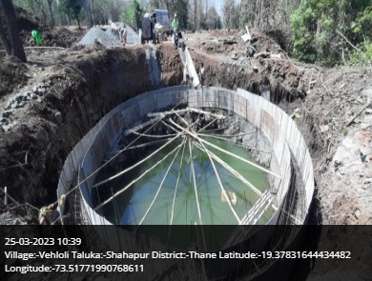
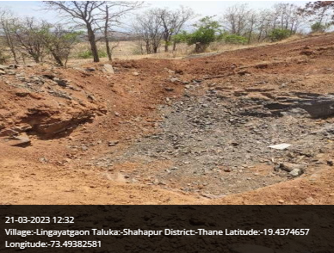
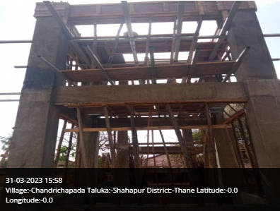
Shahapur Taluka

Slide 19
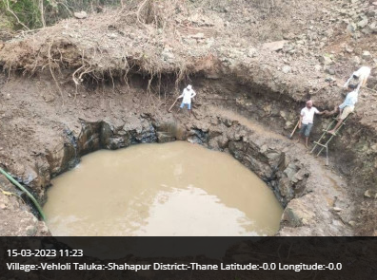
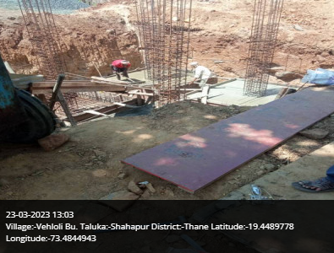
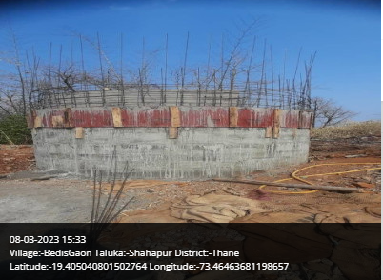
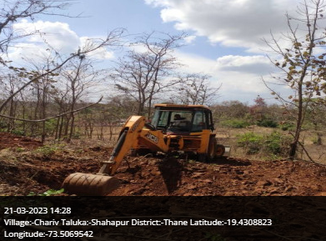
Shahapur Taluka

Slide 20
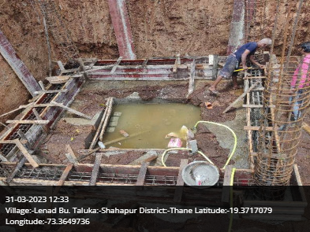
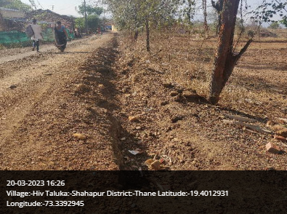
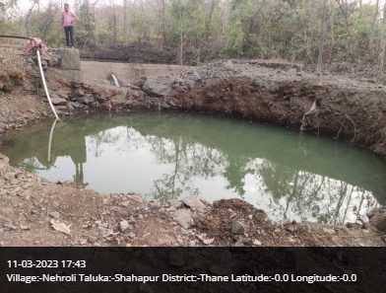
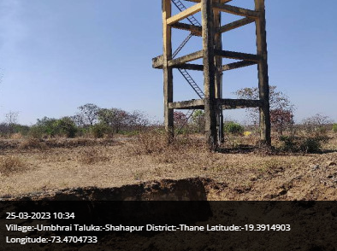
Shahapur Taluka

Slide 21
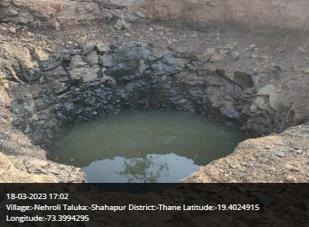
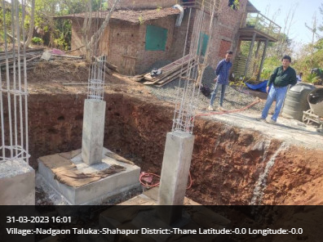
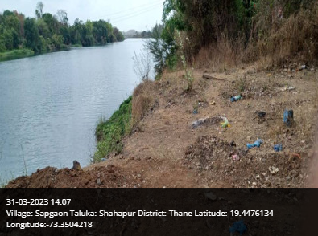
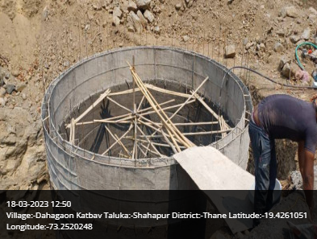
Shahapur Taluka

Slide 22
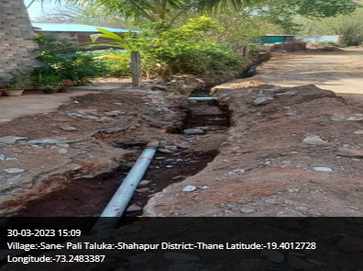
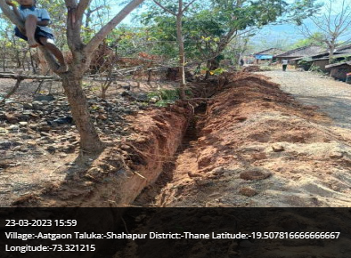
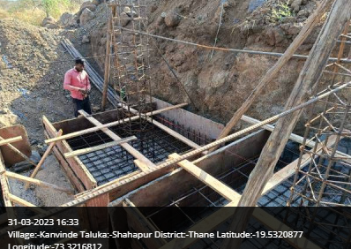
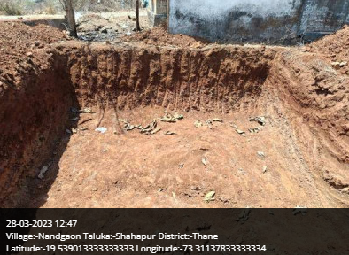
Shahapur Taluka

Slide 23
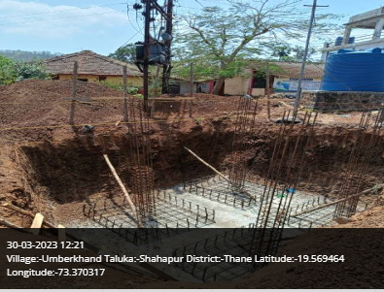
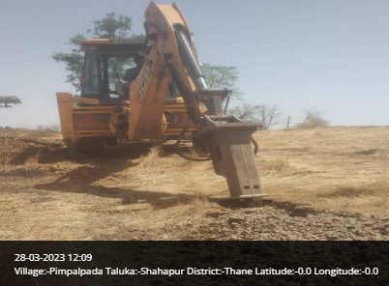
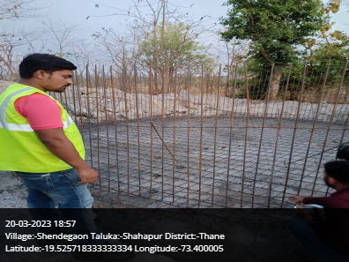
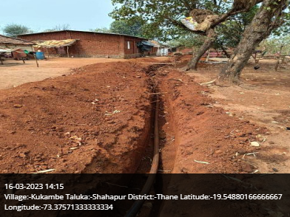
Shahapur Taluka

Slide 24
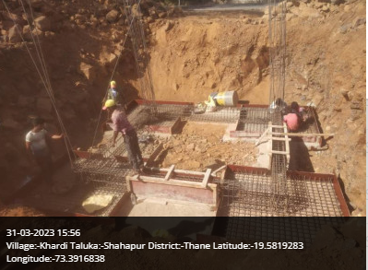
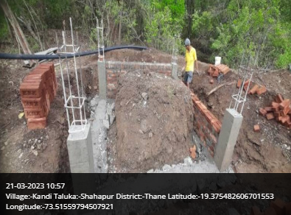
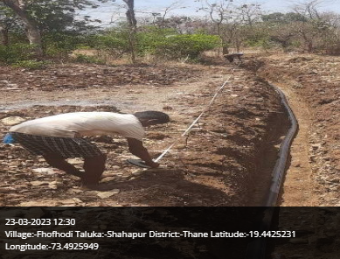
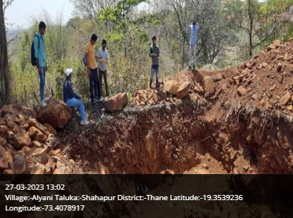
Shahapur Taluka

Slide 25
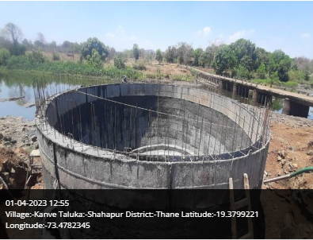
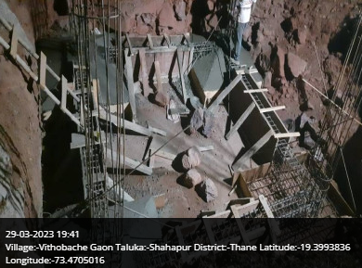
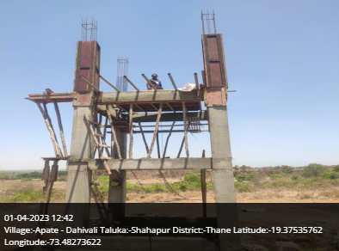
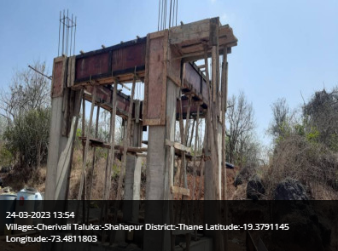
Shahapur Taluka

Slide 26
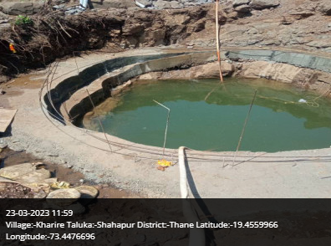
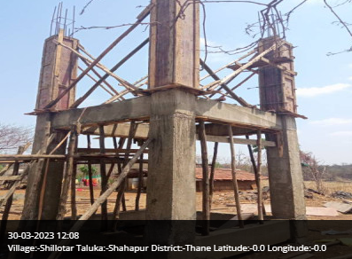
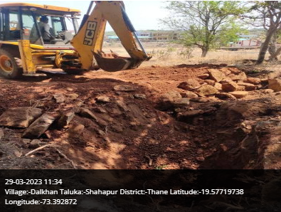
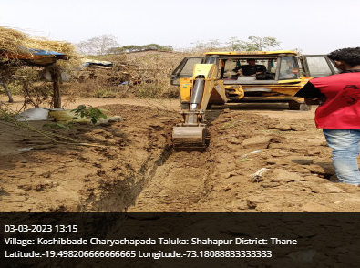
Shahapur Taluka

Slide 27

Thank You!

